Slide 1
Introduction
Attendance Management system is a system built to manage the attendance
of students, This project simplifies by automating
The tracking process. Built with user friendly features,
It allows easy recording and monitoring of attendance.

Slide 2
Existing System
The traditional attendance management system involves A pen-and-paper attendance management system for students involves manually recording attendance in a physical attendance register or sheet. This traditional method requires teachers to manually compile and tally attendance records, which can be time-consuming and prone to errors.
Proposed System
A software-based attendance management system for students is a digital platform that automates the tracking of student attendance in educational institutions. It allows teachers to mark attendance electronically through a web portal which then automatically updates the central database, This system provides real-time data, helping administrators and teachers monitor student attendance patterns, identify trends such as absenteeism, and generate reports for parents or school records.

Slide 3
Tools And Technologies Used
Java
Maven
Junit
MongoDB
OpenCSV

Slide 4
HARDAWARE REQUIREMENTS
PROCESSOR: i3 or Higher
RAM: 4GB RAM
HARD DISK DRIVE: 256 GB HDD
SOFTWARE REQUIREMENTS
ECLIPSE IDE
MONGODB COMPOSE
JDK21

Slide 5
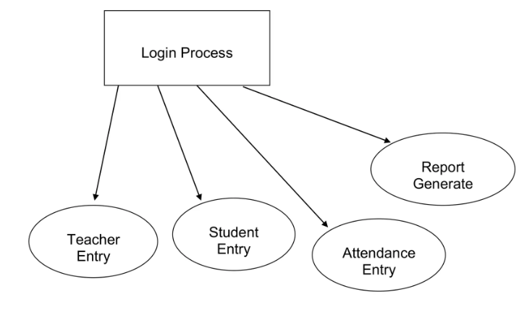
1-level DFD

Slide 6
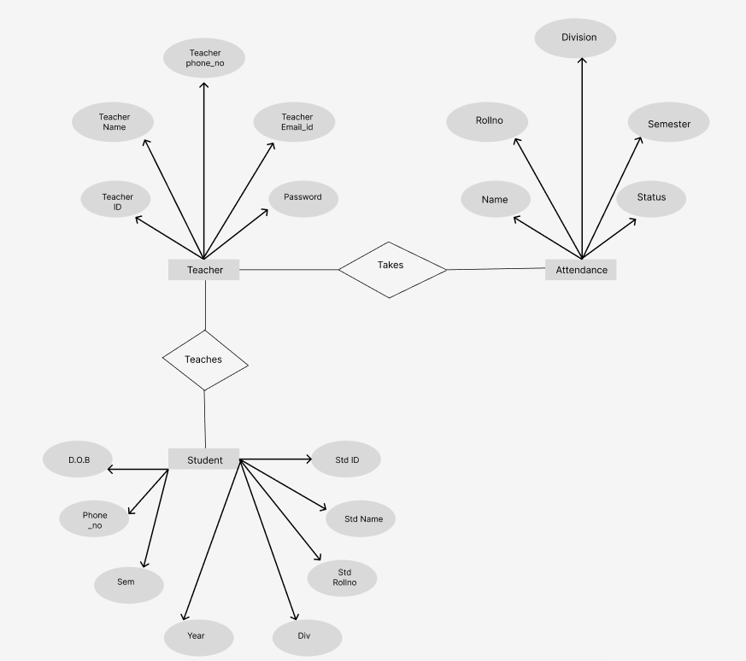
ER DIAGRAM

Slide 7
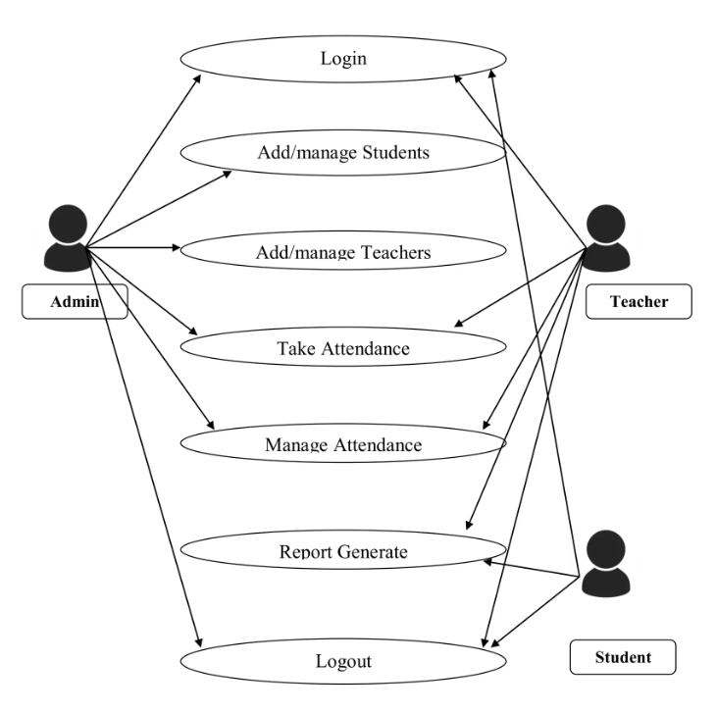
USE CASE DIAGRAM

Slide 8
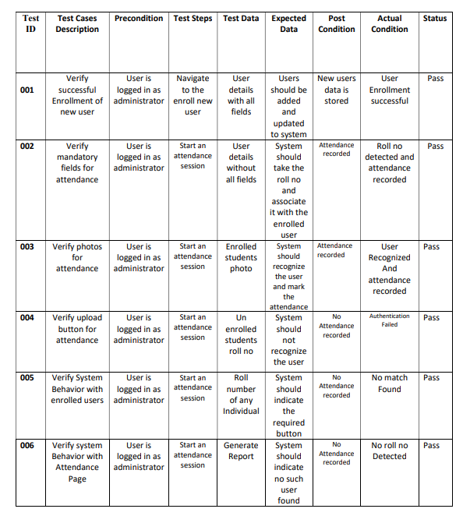
TEST CASES

Slide 9
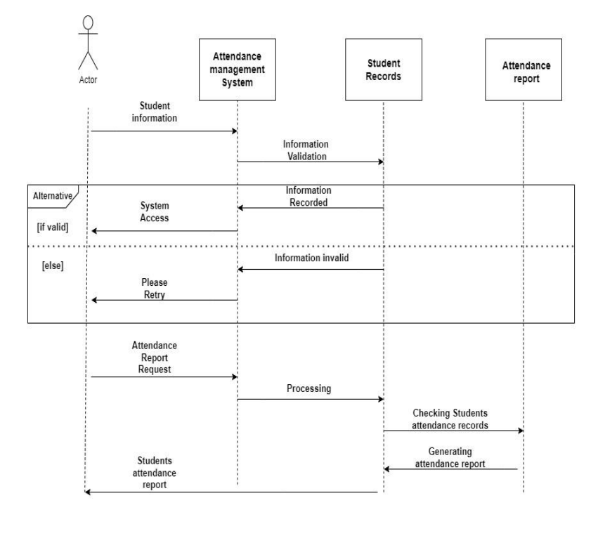
SEQUENCE DIAGRAM

Slide 10
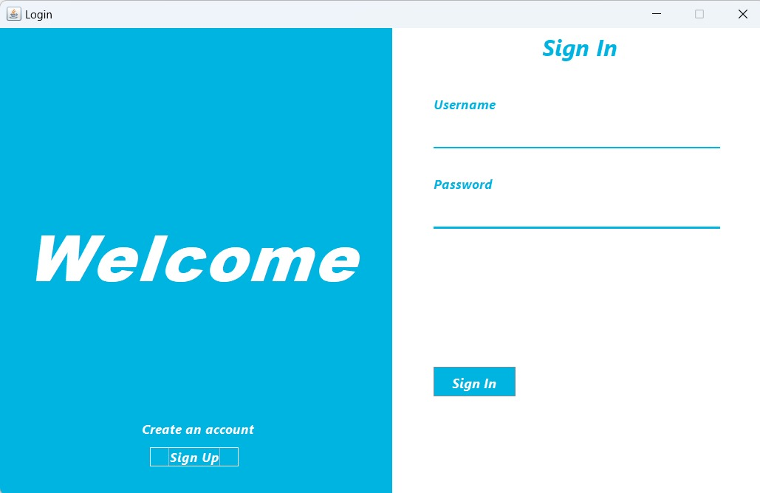
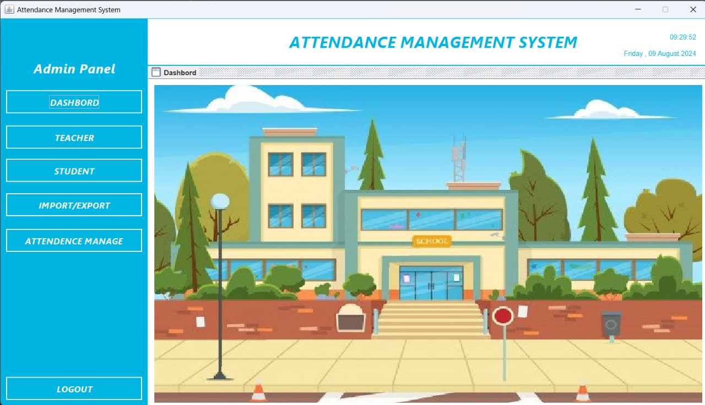
IMPLEMENTATION

Slide 11
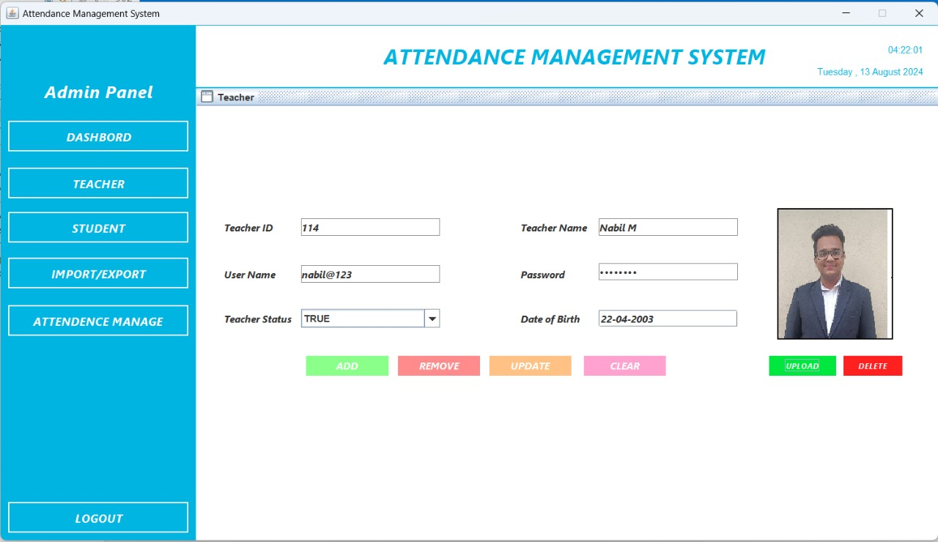
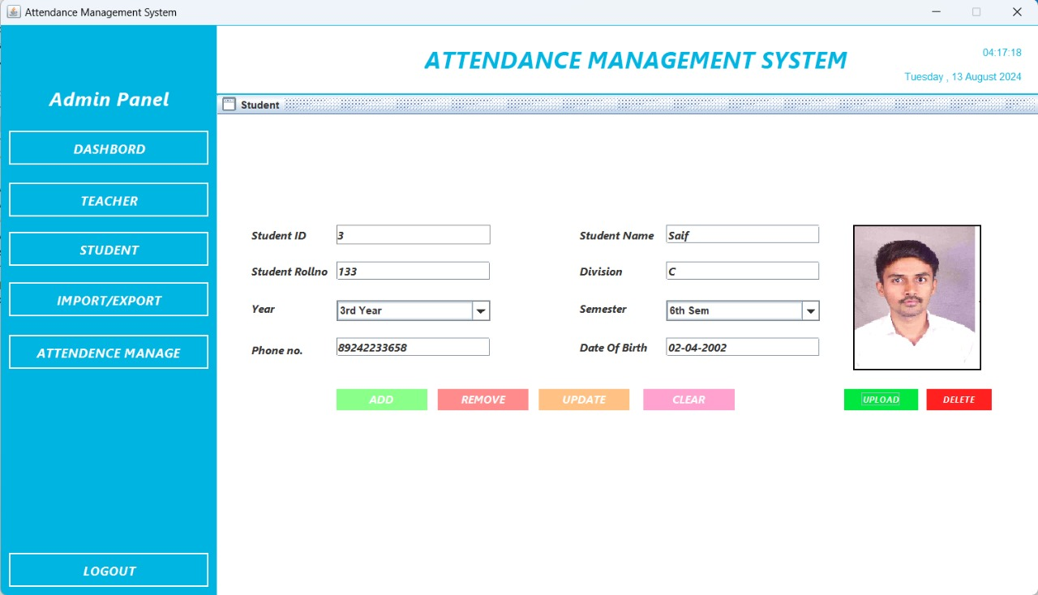

Slide 12
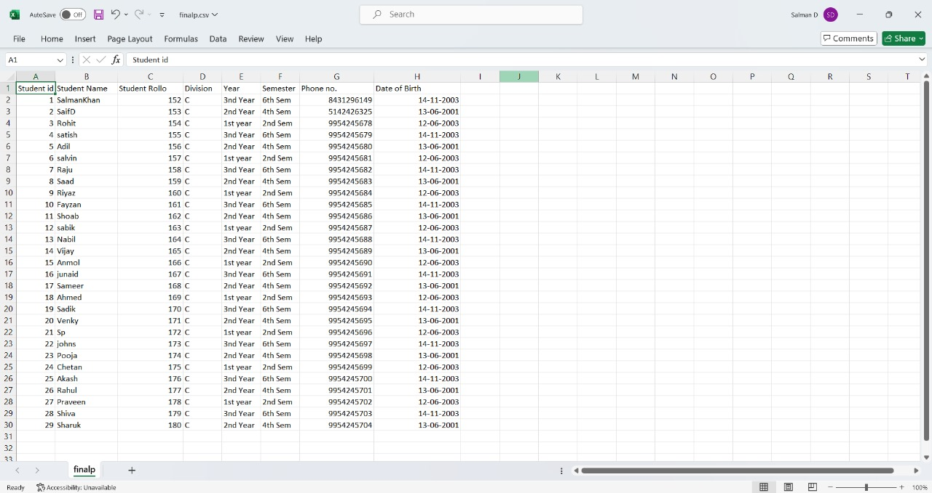
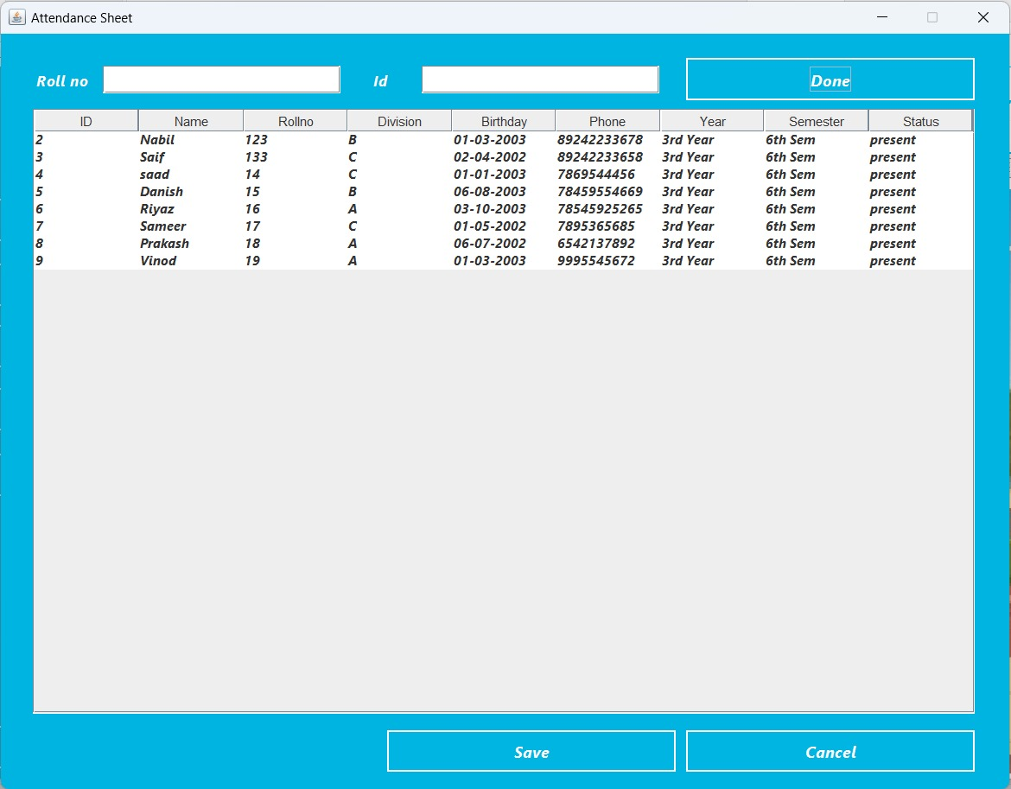

Slide 13
CONCLUSION
while both software-based and pen-and-paper attendance management systems
serve the essential purpose of tracking student attendance, they differ significantly in efficiency, The software-based system offers a modern, automated approach that simplifies attendance management, reduces errors, and provides valuable insights through real-time data and reports. On the other hand, the pen-and-paper system, though traditional and straightforward, can be time-consuming and error-prone, making it less effective in today's data-driven educational environment.
For institutions aiming to enhance administrative efficiency and improve attendance tracking, transitioning to a digital solution is a strategic choice.

